Slide 1
A Spectral-Spatial-Dependent Global Learning Framework for Insufficient and Imbalanced Hyperspectral Image Classification
Author:Qiqi Zhu, Yanfei Zhong
Published : 25 May 2021
Link : https://github.com/Praneetha65/mini-project
Name : Sita Santoshi Praneetha Athuluri
ID : 700772490

Slide 2
Introduction
Hyperspectral Image (HSI) classification is a key task in remote sensing, where each pixel is categorized into land cover types based on spectral and spatial information. However, real-world HSIs suffer from two big problems:
Insufficient labeled data – because labeling is expensive and time-consuming.
Imbalanced sample distribution – common in datasets like Indian Pines, where some classes have many samples while others have very few.
Traditional deep learning methods (e.g., CNNs, RNNs) struggle with these issues because they:
Require large labeled datasets.
Are patch-based (computationally heavy and redundant).
Often fail to exploit global spatial information.

Slide 3
overview
This paper focuses on improving how we classify hyperspectral images, especially when we don’t have enough labeled data or when the data is uneven across classes.
The authors introduce a new method called SSDGL, which looks at the whole image instead of breaking it into small patches like older methods.
It includes two smart tools:
GCL helps understand relationships between different wavelengths in the image.
GJAM helps the model focus on the most important parts of the image.
They also use a special sampling trick and a weighted loss to make sure small or rare classes are not ignored.
Overall, the method works better and faster than many older techniques, even when very little training data is available.

Slide 4
Data Set :
Indian Pines (IP)
Includes various agricultural land-cover types.
This dataset is known for imbalanced and insufficient samples, making it ideal to test SSDGL’s robustness.
Pavia University (PU)
Urban scene captured over the University of Pavia, Italy.
Challenges include high spatial resolution and fine texture details.
Houston University (HU)
Complex urban scene with buildings, roads, grass, and more.
Ideal for testing performance on extremely limited training data.
Data set | IP’s Data set | PU data set | HU data set
Train samples | 529 | 432 | 150
Test samples | 9720 | 42344 | 14861
Number of classes | 16 | 9 | 15

Slide 5
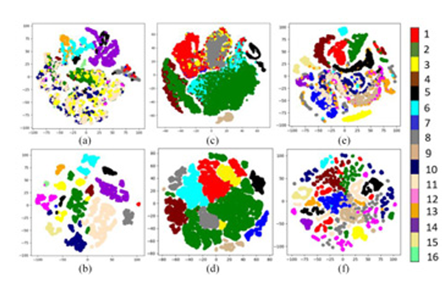
Models
RBF-SVM – Radial Basis Function - Support Vector Machine
SS-CNN – Spectral-Spatial Convolutional Neural Network
SSRN – Spectral-Spatial Residual Network
DBMA – Dual-Branch Multi-Attention
MCNN – Multi-scale Convolutional Neural Network
ConvLSTM – Convolutional Long Short-Term Memory
U-Net – U-shaped Convolutional Network
2-D t-SNE visualization of features

Slide 6
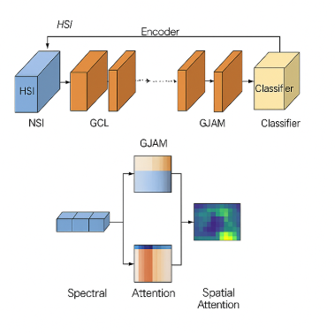
Model Performance with SSDGL
To tackle issues like insufficient and imbalanced samples in hyperspectral image (HSI) classification, the SSDGL framework was introduced. It moves beyond traditional patch-based methods by using the whole image as input. SSDGL integrates advanced components like global convolutional LSTM (GCL) and a global joint attention mechanism (GJAM) to capture meaningful spectral-spatial features and emphasize important regions. A custom sampling method and weighted loss function help balance learning across all classes.
During training, a hierarchically balanced (H-B) sampling strategy was used to ensure fair representation of each class. A weighted softmax loss helped the model focus more on underrepresented and difficult-to-classify categories. These techniques improved generalization and performance across different datasets.

Slide 7
Plotting Accuracy, Loss, and Model Evaluation (SSDGL Framework)
The SSDGL model achieved over 99% overall accuracy on the Indian Pines dataset
using only 5% labeled samples.
Validation results showed excellent generalization across datasets with
varying spatial resolution and class imbalance.
Training and validation loss decreased smoothly, showing stable convergence.
The confusion matrix showed high true positive rates across all classes, even for minority
classes with very few samples.
Thanks to the hierarchically balanced sampling and weighted softmax loss
the model maintained high performance even on imbalanced data.
Overall, SSDGL outperformed previous methods like SSRN, U-Net, and FPGA by 2–10% in accuracy
depending on the dataset.

Slide 8
CNN-BASED | FCN-based
Class | Rbf-svm | SS-cnn | SSRN | DBMA | MCNN-conlstm | U-net
OA(overall accuracy) | 75.31 | 89.82 | 92.21 | 94.43 | 94.78 | 93.20
AA(average accuracy) | 71.12 | 83.73 | 93.03 | 93.81 | 93.37 | 92.11
Kappa(cohen’s kappa coefficient) | 0.7173 | 0.8783 | 0.9115 | 0.9365 | 0.9437 | 0.9222
Proposed
99.63
99.79
0.9958
classification report

Slide 9
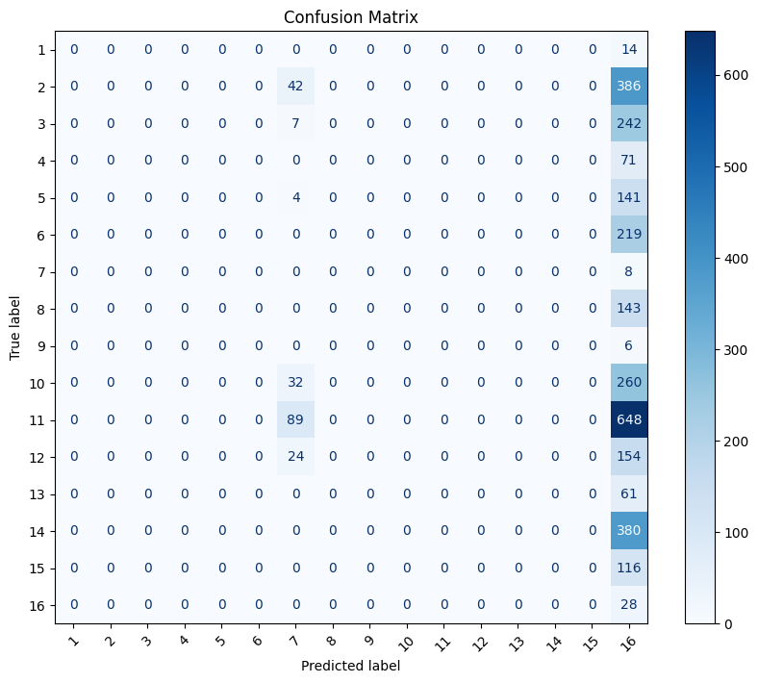
confusion matrix

